Slide 1
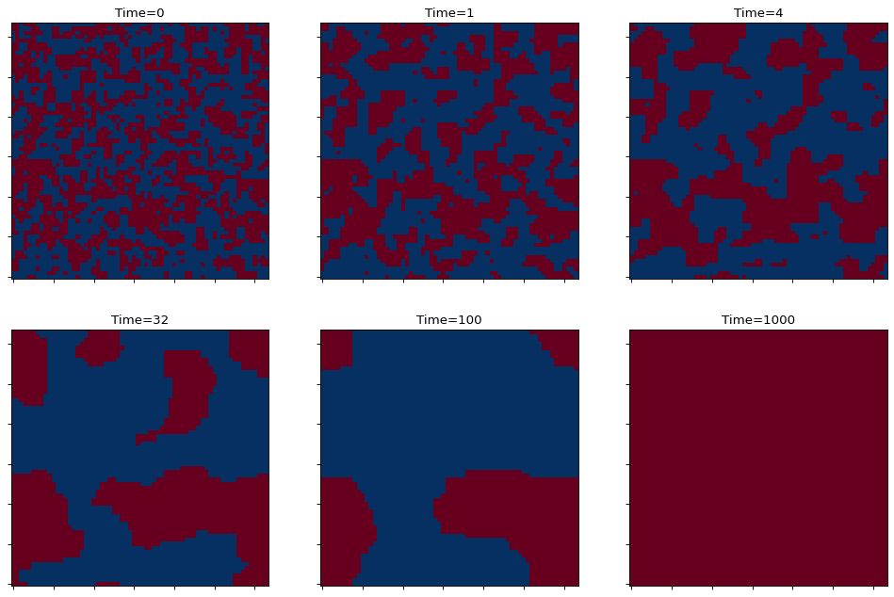


In-Class Problem: Metropolis Method
Canvas -> Modules -> Week 6
Complete “11_InClass”
Start with a random initial state and then plot the instantaneous configurations for a square lattice with no external magnetic field and with periodic boundary conditions. We will also assume a constant strength of exchange between nearest-neighbors.
$$A =\min\left(1,e^{{(E}_{i}−E_{j})/T}\right)=min(1,e^{\frac{dE}{T}})$$
where $dE$ is difference of spin flip on specific site times sum of spins for all NN

Slide 3
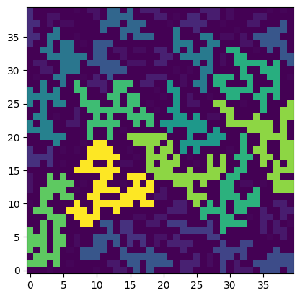
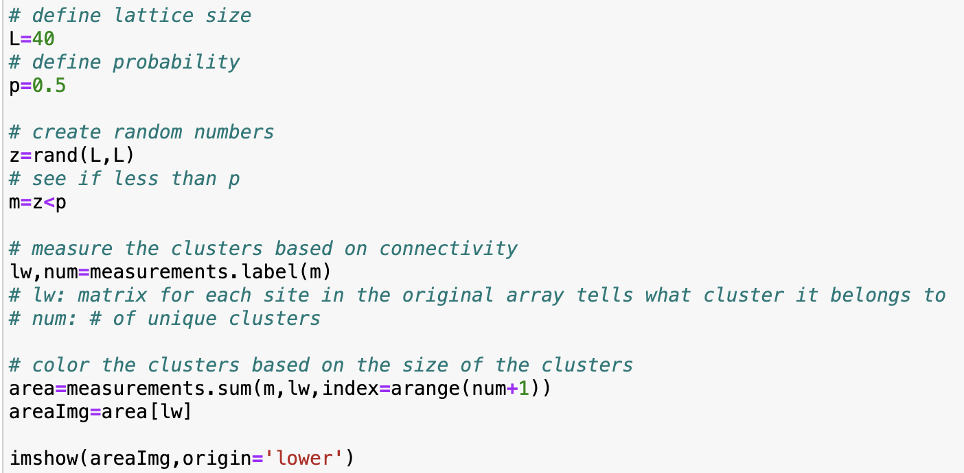
Python Example: Site Percolation
Canvas -> Modules -> Week 6
Download “13_InClass”

Slide 4
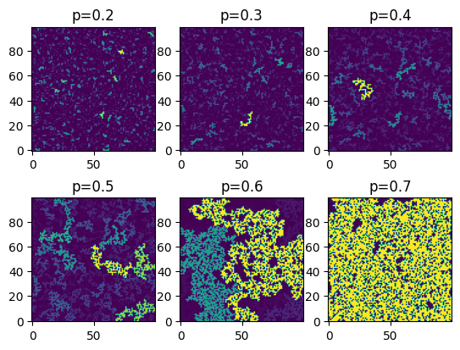

Slide 5
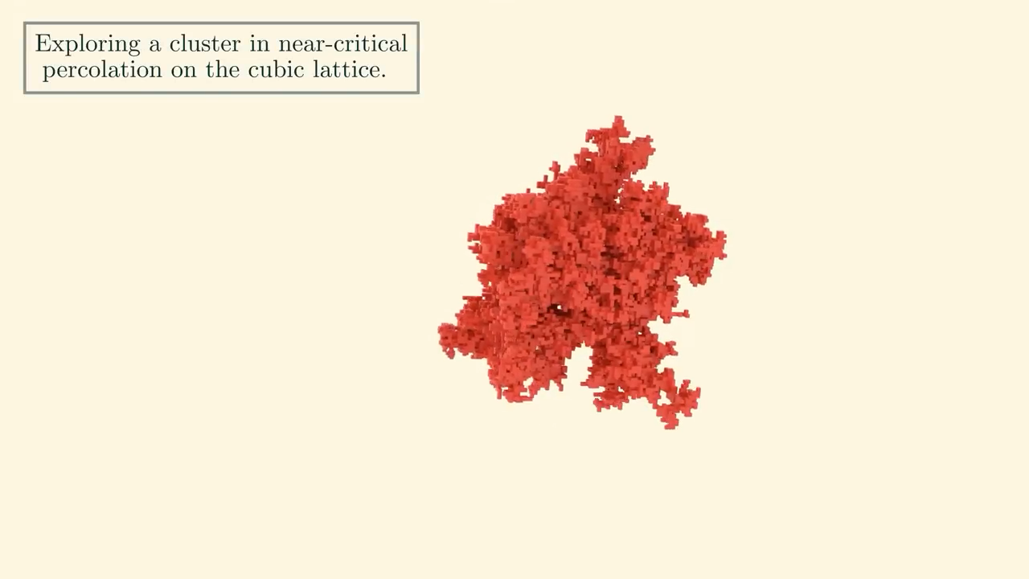
Python Example: Site Percolation
Canvas -> Modules -> Week 6
Download “13_InClass”
from scipy.ndimage import measurements
Lattice size of 40
Vary percolation probability (p)
from scipy.ndimage import measurements

Slide 6
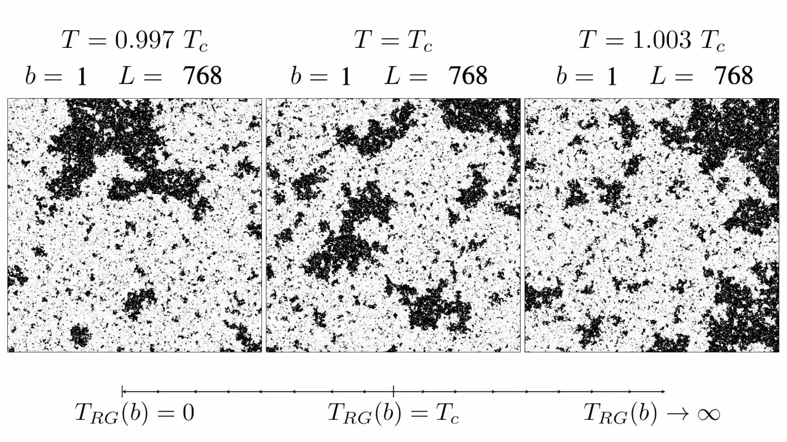
Ising Model: Site Percolation

Slide 7
Monte Carlo Module Summary
Random Processes
Monte Carlo Integration
Importance Sampling
Monte Carlo Methods
Markov Chain
Metropolis algorithm
Site Percolation
[adjacent]
[TODAY]
Ising Model
Metropolis Alg
Site Percolation
Week 7: Parallel Processing

